Slide 1
Deep Learning Primer
Swadhin Pradhan
Reading Group Presentation
03/30/2016, UT Austin

Slide 2
Why should we care ?

Slide 3
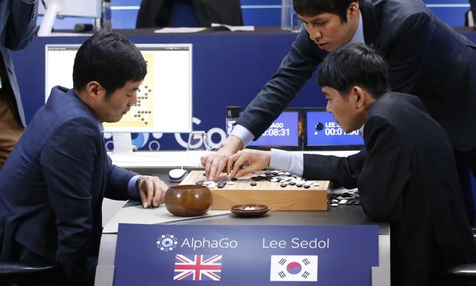
DeepMind’s AlphaGo beats Lee Sedol 4-1 in Go !!

Slide 4
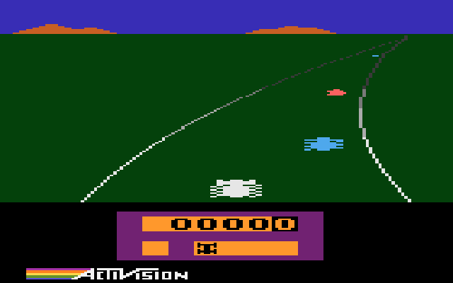
Deep Learning played Atari better !!
Enduro, Atari 2600
Expert player: 368 points Deep Learning: 661 points
Playing Atari with Deep Reinforcement Learning Volodymyr Mnih, Koray Kavukcuoglu, David Silver, Alex Graves, Ioannis Antonoglou, Daan Wierstra, Martin Riedmiller

Slide 5
Error rate came from ~25% to ~5%
Source: Huang et al., Communications ACM 01/2016

Slide 6

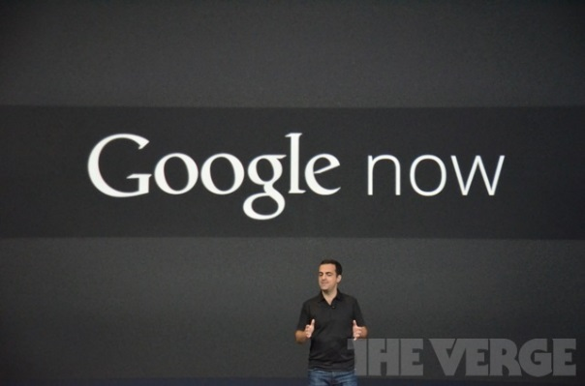
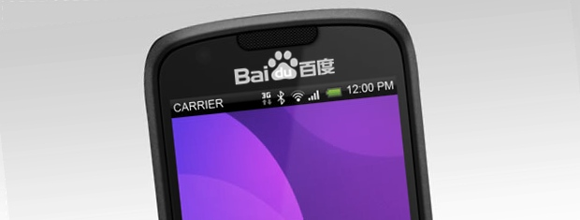


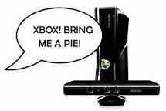
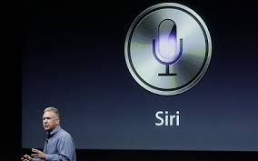
Impact of deep learning in speech technology

Slide 7
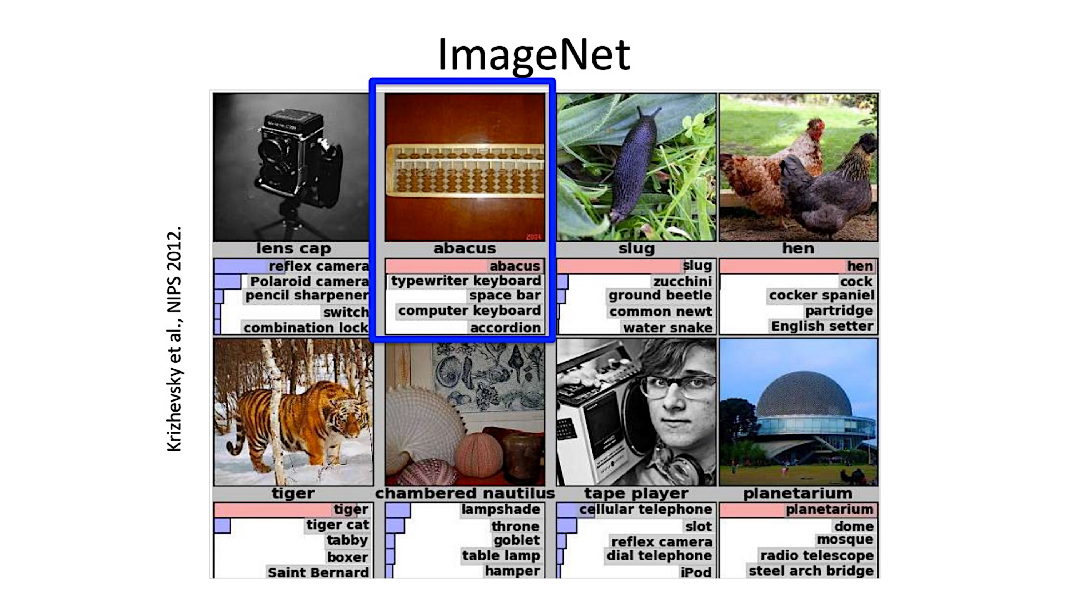

Slide 8
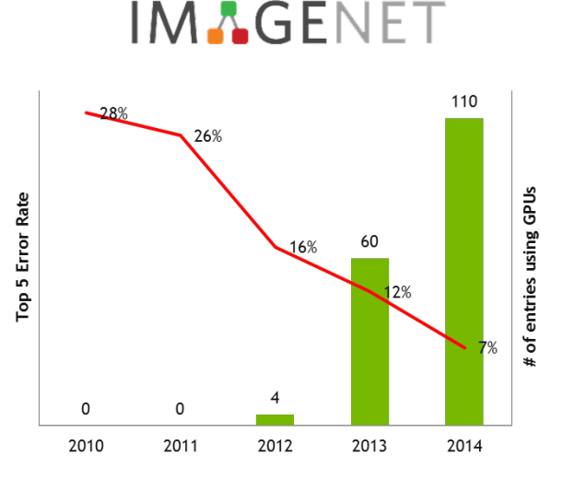
Large Scale Visual Image Challenge
Error rate came from ~28% to ~5% > Better than Human Judge !!

Slide 9
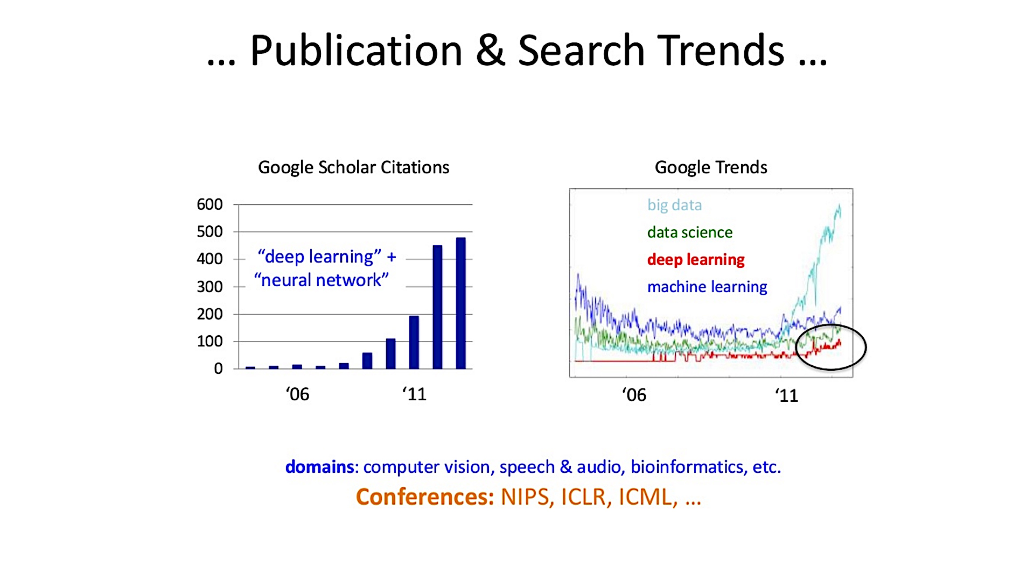

Slide 10
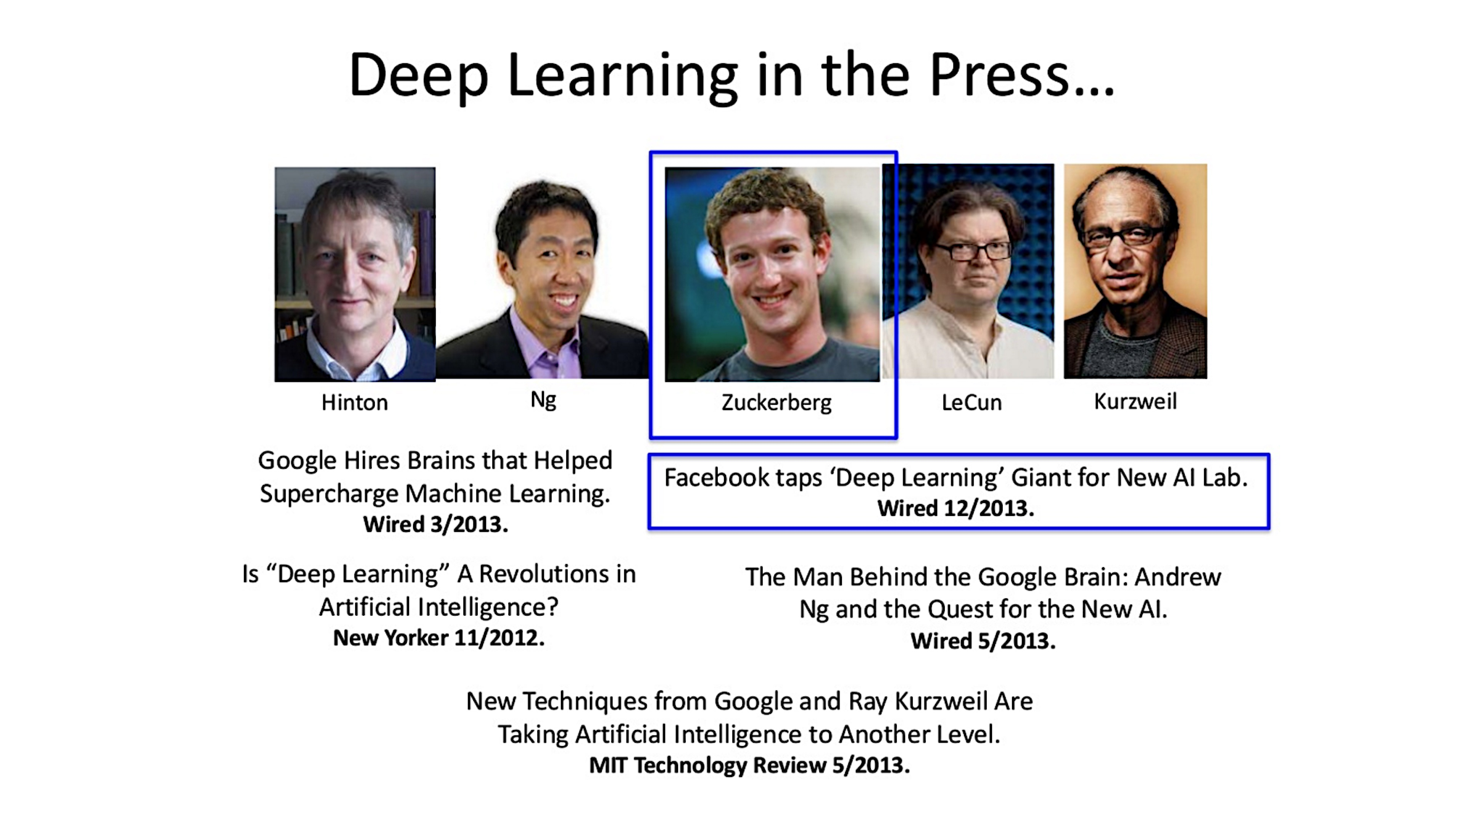

Slide 11
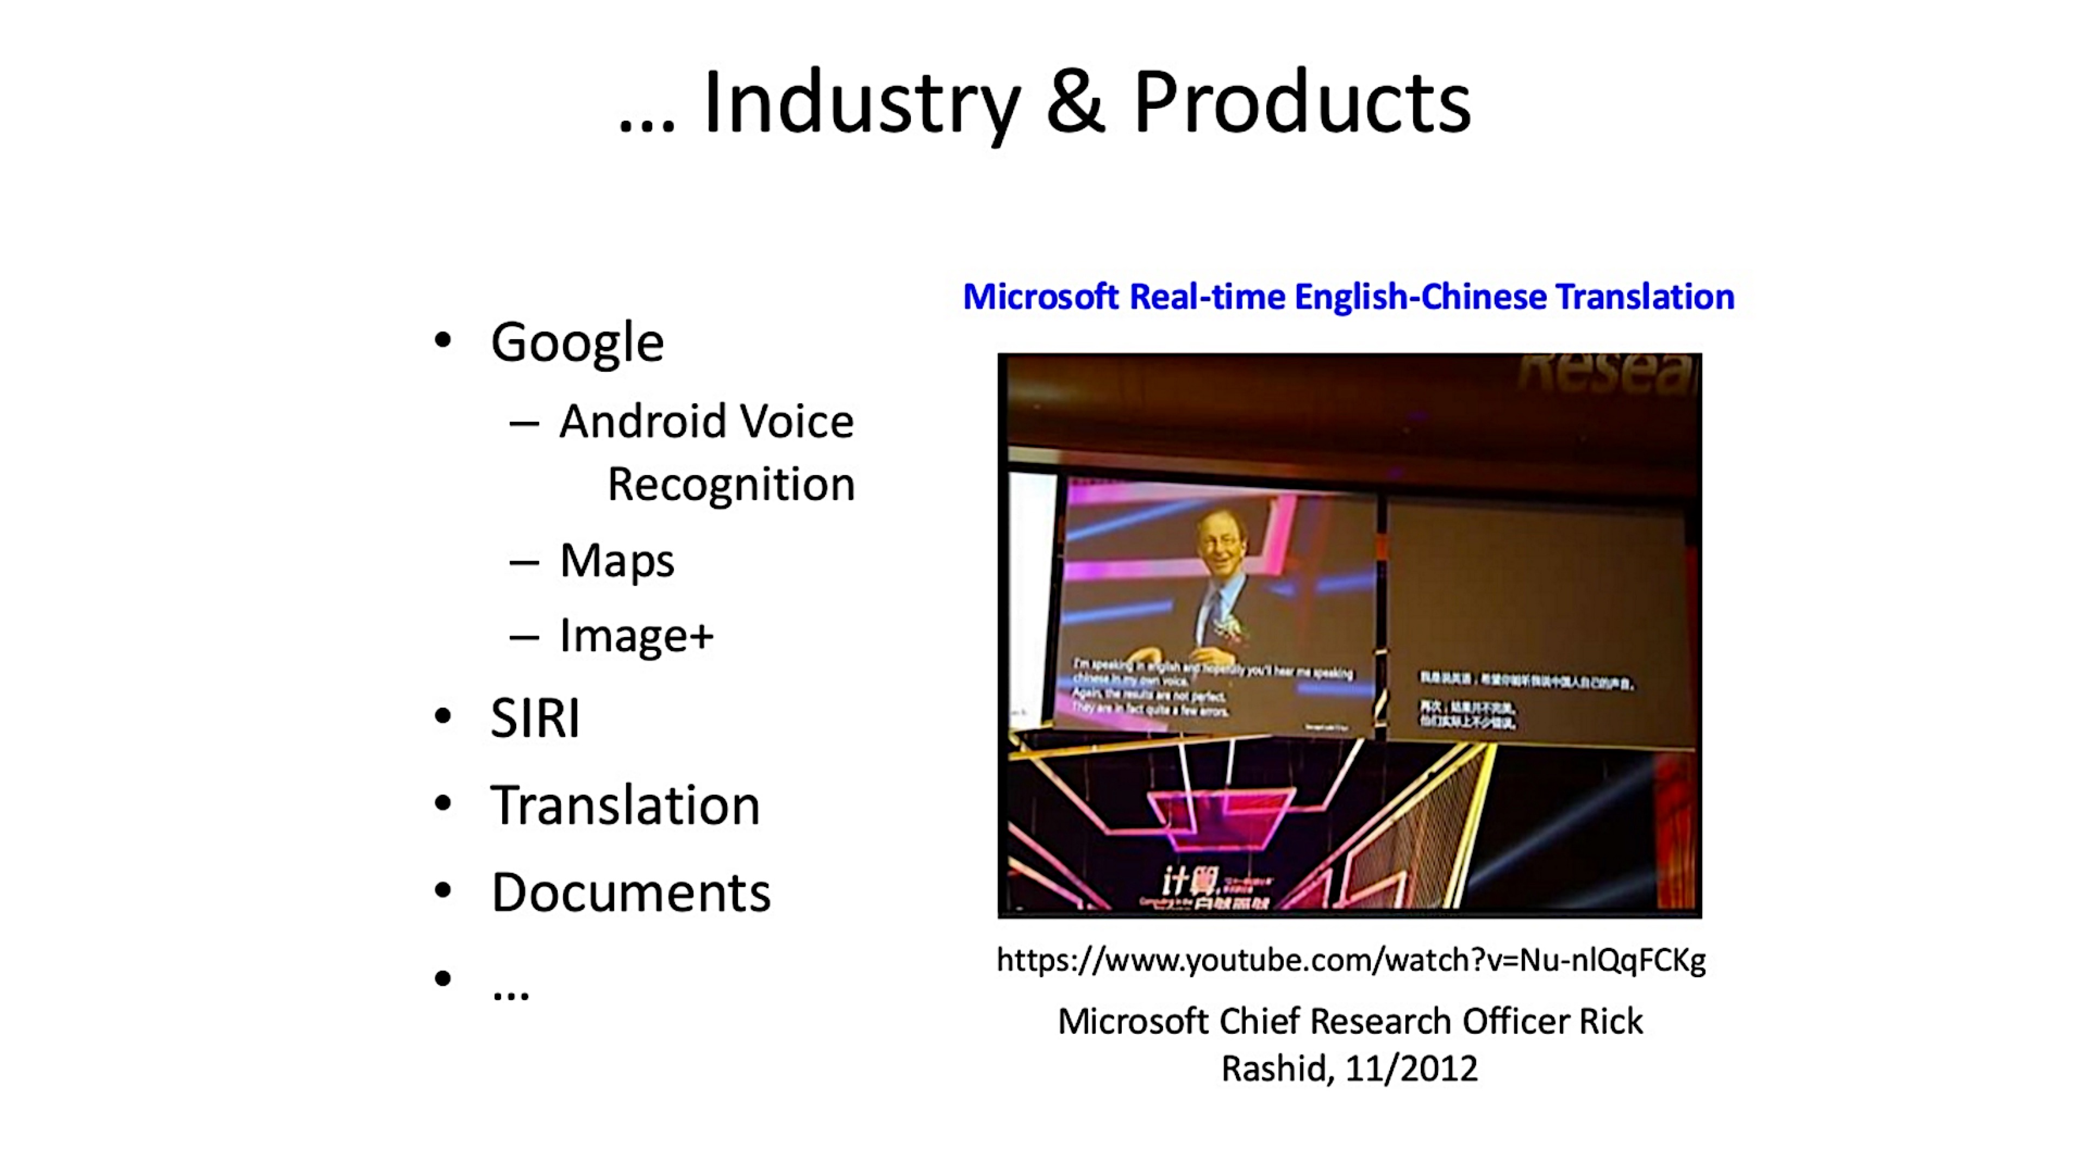

Slide 12
Big Picture

Slide 13
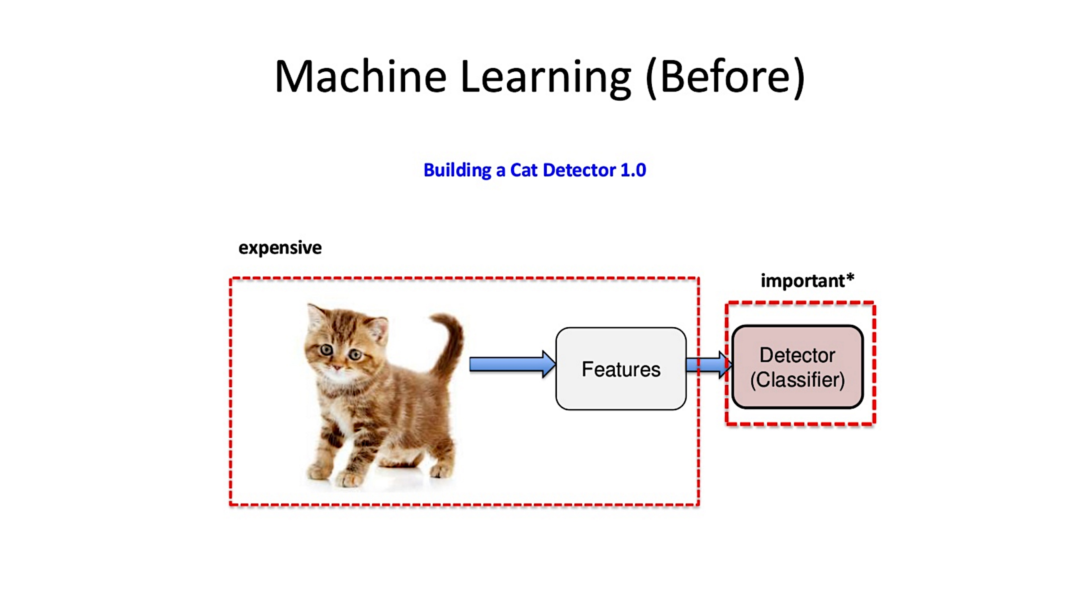

Slide 14
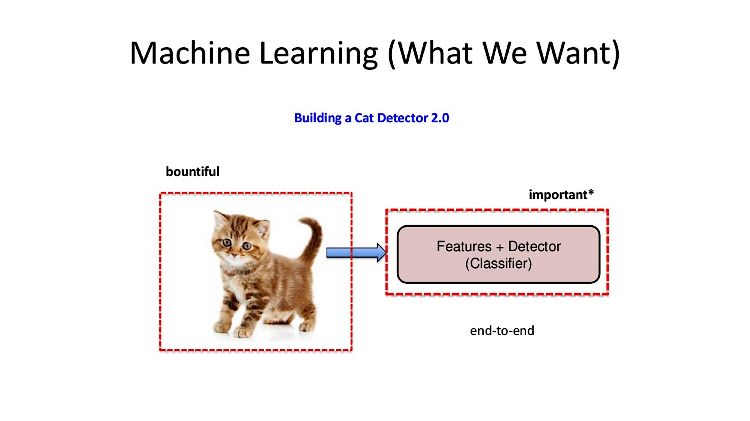

Slide 15
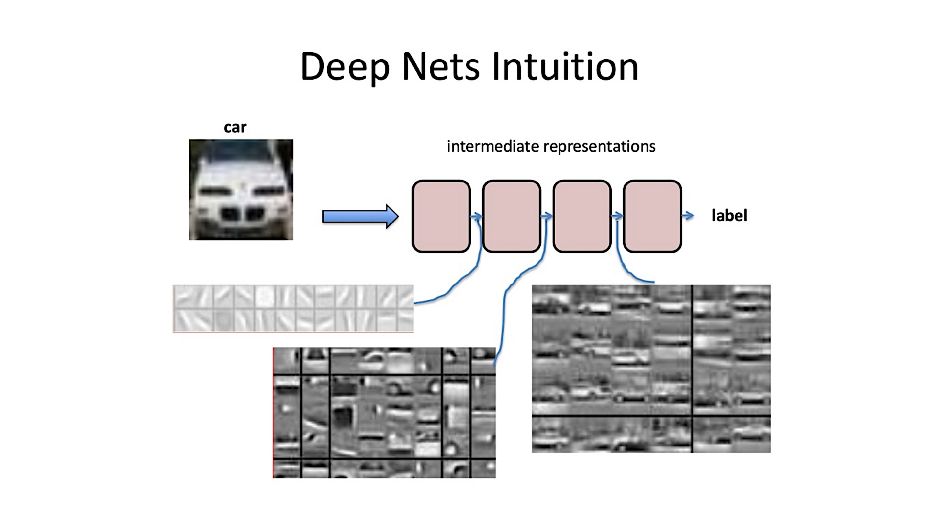

Slide 16
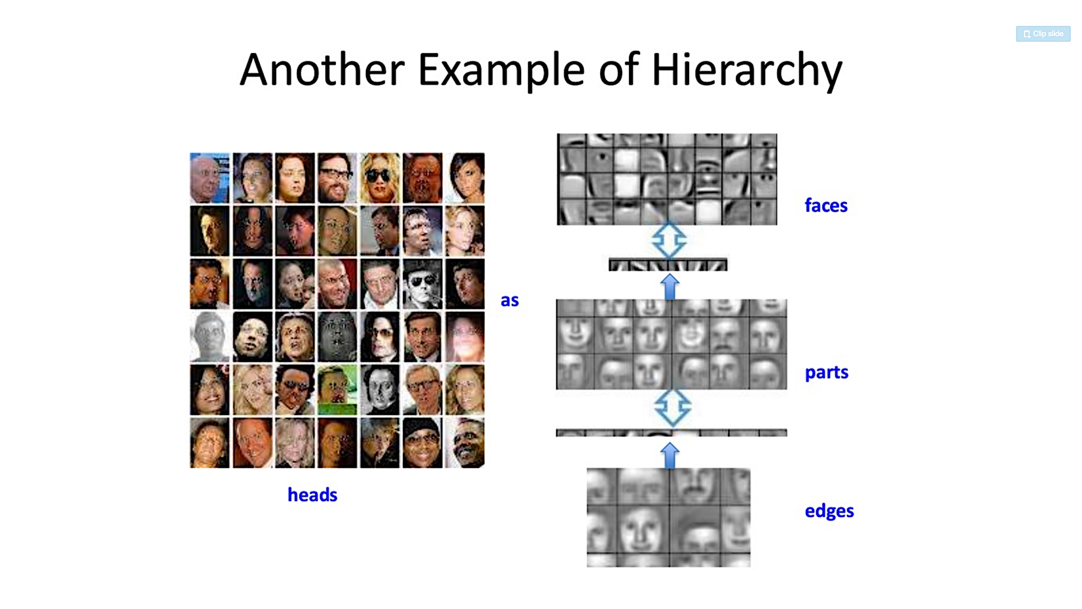

Slide 17
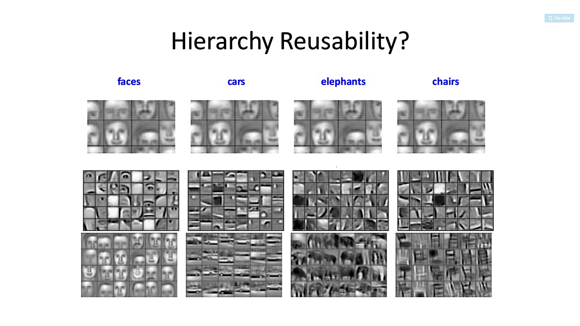

Slide 18
Key Ideas
Learn features from Data
Use all data
Deep Architecture
Representation
Computational efficiency
Shared Statistics
Practical Training
It worked ☺ but still not enough theoretical reasoning ….

Slide 19
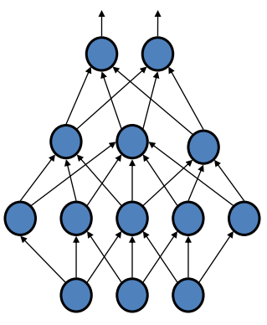
Deep Architecture
Multiple hidden layers
Motivation (why go deep?)
Approximate complex decision boundary
Fewer computational units for same functional mapping
Hierarchical Learning
Increasingly complex features
work well in different domains
Vision, Audio, …

Slide 20
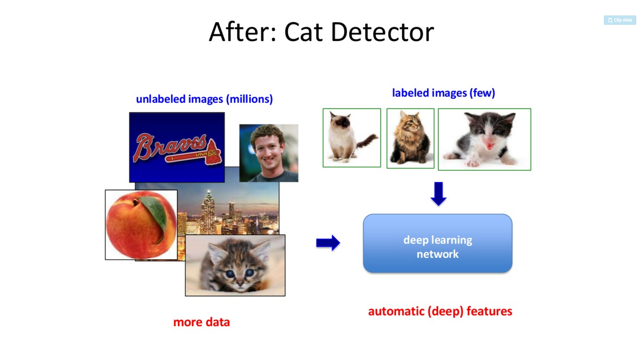

Slide 21
Detail

Slide 22
So, 1. what exactly is deep learning ?
And, 2. why is it generally better than other methods on image, speech and certain other types of data?

Slide 23
So, 1. what exactly is deep learning ?
And, 2. why is it generally better than other methods on image, speech and certain other types of data?
The short answers
1. ‘Deep Learning’ means using a neural network
with several layers of nodes between input and output
2. the series of layers between input & output do
feature identification and processing in a series of stages,
just as our brains seem to.

Slide 24
hmmm… OK, but:
3. multilayer neural networks have been around for
25 years. What’s actually new?

Slide 25
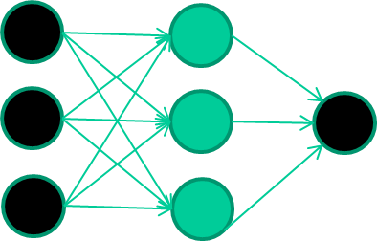
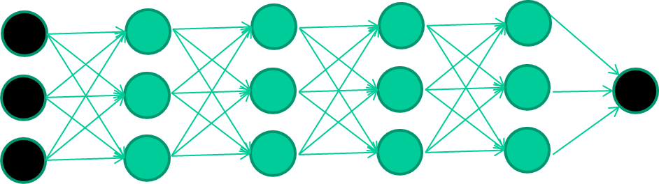
hmmm… OK, but:
3. multilayer neural networks have been around for
25 years. What’s actually new?
we have always had good algorithms for learning the
weights in networks with 1 hidden layer
but these algorithms are not good at learning the weights for
networks with more hidden layers
what’s new is: algorithms for training many-later networks

Slide 26
longer answers
reminder/quick-explanation of how neural network weights are learned;
the idea of unsupervised feature learning (why ‘intermediate features’ are important for difficult classification tasks, and how NNs seem to naturally learn them)
The ‘breakthrough’ – the simple trick for training Deep neural networks

Slide 27
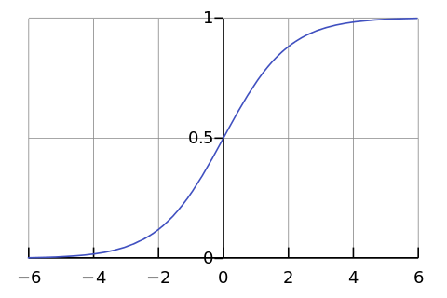
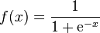
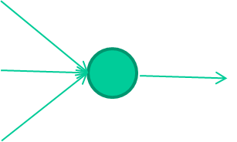
-0.06
W1
W2
f(x)
-2.5
W3
1.4

Slide 28
-0.06
2.7
-8.6
f(x)
-2.5
0.002
x = -0.06×2.7 + 2.5×8.6 + 1.4×0.002 = 21.34
1.4

Slide 29
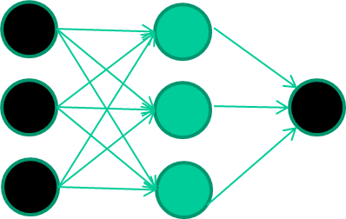
A dataset
Fields class
1.4 2.7 1.9 0
3.8 3.4 3.2 0
6.4 2.8 1.7 1
4.1 0.1 0.2 0
etc …

Slide 30
Training the neural network
Fields class
1.4 2.7 1.9 0
3.8 3.4 3.2 0
6.4 2.8 1.7 1
4.1 0.1 0.2 0
etc …

Slide 31
Training data
Fields class
1.4 2.7 1.9 0
3.8 3.4 3.2 0
6.4 2.8 1.7 1
4.1 0.1 0.2 0
etc …
Initialise with random weights

Slide 32
Training data
Fields class
1.4 2.7 1.9 0
3.8 3.4 3.2 0
6.4 2.8 1.7 1
4.1 0.1 0.2 0
etc …
Present a training pattern
1.4
2.7
1.9

Slide 33
Training data
Fields class
1.4 2.7 1.9 0
3.8 3.4 3.2 0
6.4 2.8 1.7 1
4.1 0.1 0.2 0
etc …
Feed it through to get output
1.4
2.7 0.8
1.9

Slide 34
Training data
Fields class
1.4 2.7 1.9 0
3.8 3.4 3.2 0
6.4 2.8 1.7 1
4.1 0.1 0.2 0
etc …
Compare with target output
1.4
2.7 0.8
0
1.9 error 0.8

Slide 35


Training data
Fields class
1.4 2.7 1.9 0
3.8 3.4 3.2 0
6.4 2.8 1.7 1
4.1 0.1 0.2 0
etc …
Adjust weights based on error
1.4
2.7 0.8
0
1.9 error 0.8

Slide 36
Training data
Fields class
1.4 2.7 1.9 0
3.8 3.4 3.2 0
6.4 2.8 1.7 1
4.1 0.1 0.2 0
etc …
Present a training pattern
6.4
2.8
1.7

Slide 37
Training data
Fields class
1.4 2.7 1.9 0
3.8 3.4 3.2 0
6.4 2.8 1.7 1
4.1 0.1 0.2 0
etc …
Feed it through to get output
6.4
2.8 0.9
1.7

Slide 38
Training data
Fields class
1.4 2.7 1.9 0
3.8 3.4 3.2 0
6.4 2.8 1.7 1
4.1 0.1 0.2 0
etc …
Compare with target output
6.4
2.8 0.9
1
1.7 error -0.1

Slide 39
Training data
Fields class
1.4 2.7 1.9 0
3.8 3.4 3.2 0
6.4 2.8 1.7 1
4.1 0.1 0.2 0
etc …
Adjust weights based on error
6.4
2.8 0.9
1
1.7 error -0.1

Slide 40
Training data
Fields class
1.4 2.7 1.9 0
3.8 3.4 3.2 0
6.4 2.8 1.7 1
4.1 0.1 0.2 0
etc …
And so on ….
6.4
2.8 0.9
1
1.7 error -0.1
Repeat this thousands, maybe millions of times – each time
taking a random training instance, and making slight
weight adjustments
Algorithms for weight adjustment are designed to make
changes that will reduce the error

Slide 41
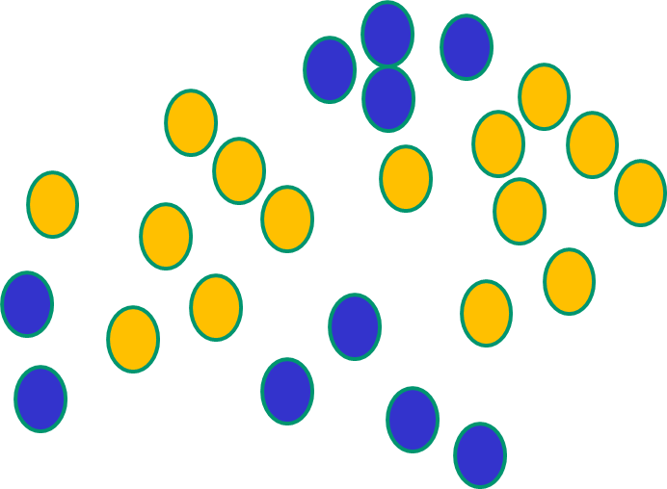
Why non-linear function ?
NNs use nonlinear f(x) so they SVMs only draw straight lines,
can draw complex boundaries, but they transform the data first
but keep the data unchanged in a way that makes that OK

Slide 42
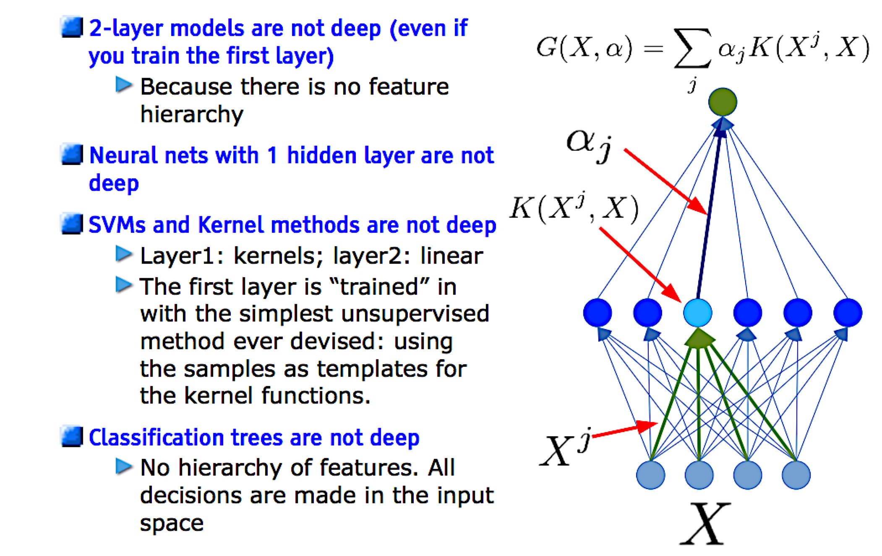
Which models are deep ?

Slide 43
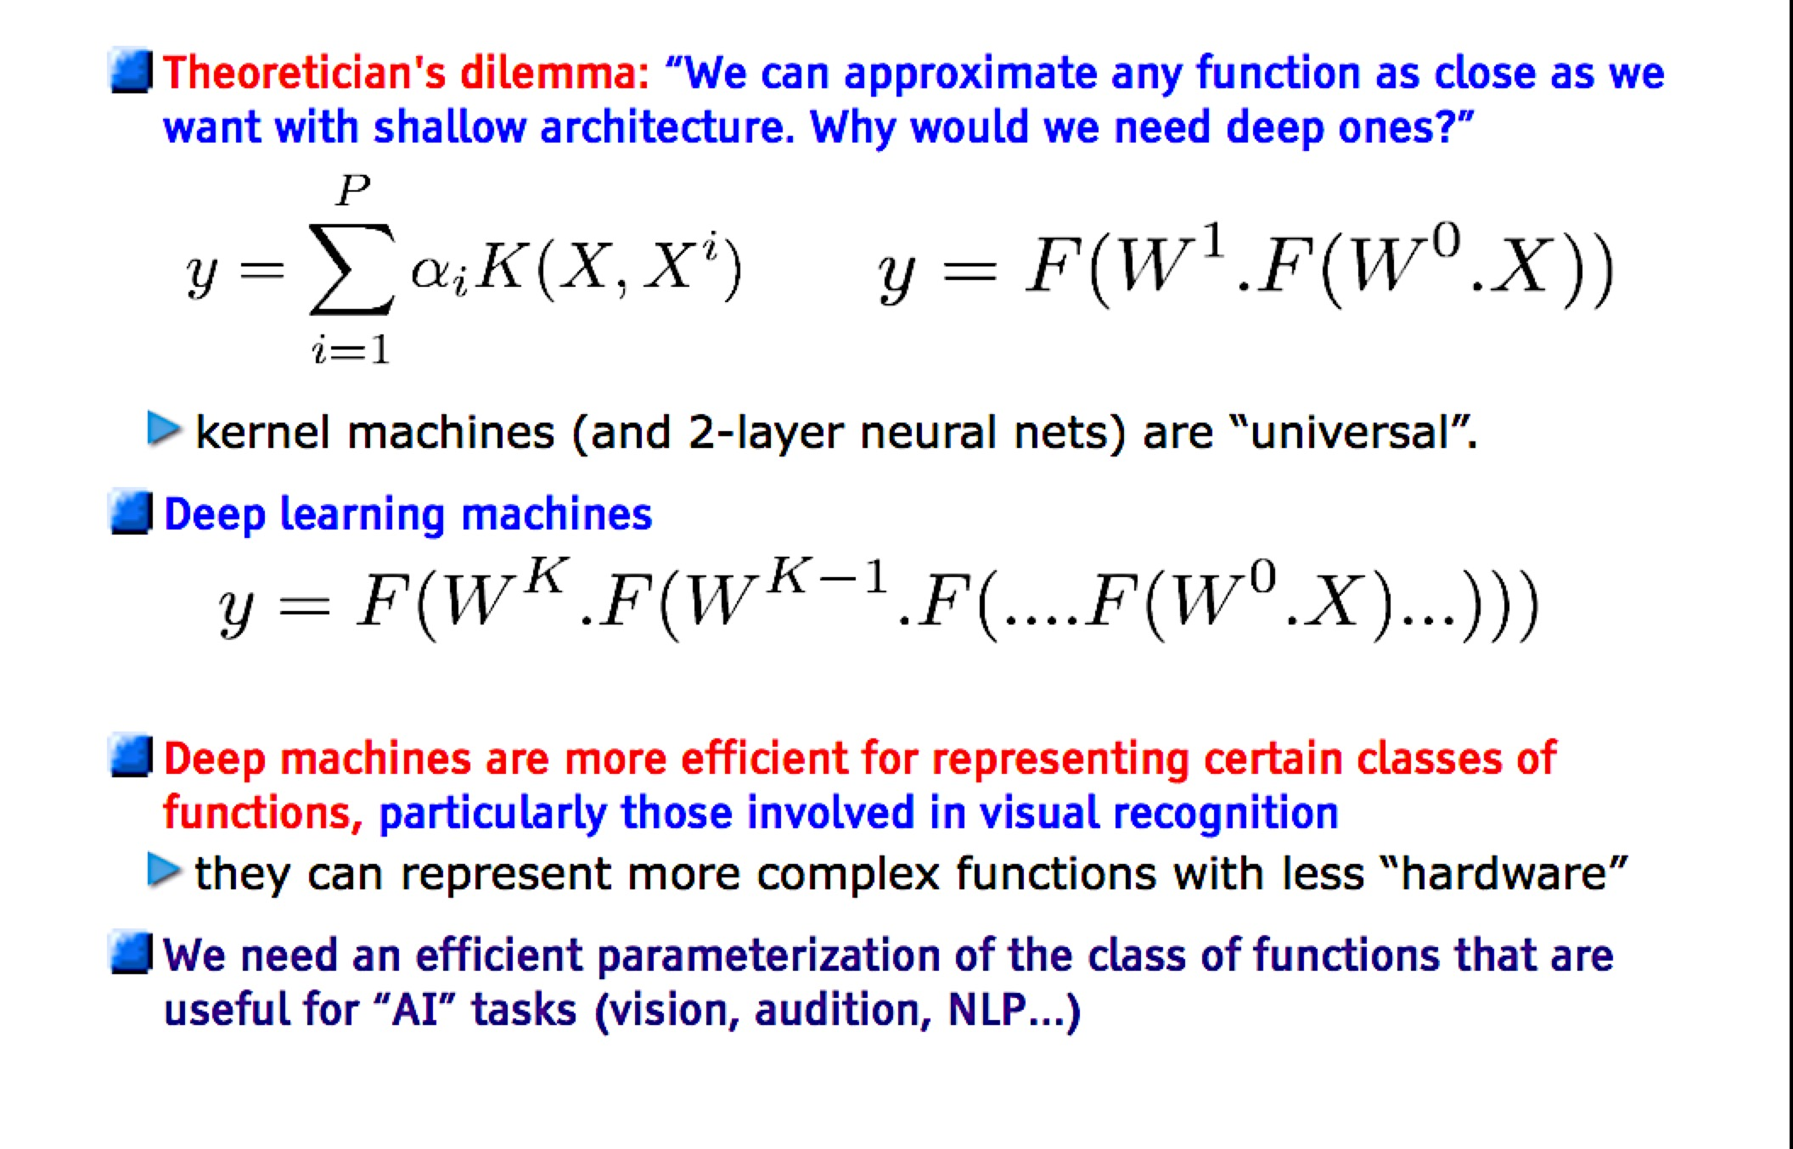
Do we really need deep architectures ?

Slide 44
Multi Layer Perceptron
Multiple Layers
Feed Forward
Connected Weights
1-of-N Output
[ Y₁ , Y₂ ]
k
output
w_{jk}
hidden
j
1
v_{ij}
0
i
input
0
[ X₁ , X₂ , X₃ ]

Slide 45
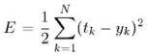
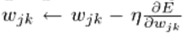
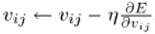
Backpropagation
Minimize error of calculated output
Adjust weights
Gradient Descent
Procedure
Forward Phase
Backpropagation of errors
For each sample, multiple epochs
k
w_{jk}
j
v_{ij}
i

Slide 46
Problems with Backpropagation
Multiple hidden Layers
Get stuck in local optima
start weights from random positions
Slow convergence to optimum
large training set needed
Only use labeled data
most data is unlabeled
Generative Approach

Slide 47
Outline
Deep learning
Greedy layer-wise training (for supervised learning)
Deep belief nets
Stacked denoising auto-encoders
Stacked predictive sparse coding
Deep Boltzmann machines
Convolutional Neural Net

Slide 48
Deep Network Training (that actually works)
Use unsupervised learning (greedy layer-wise
training)
Allows abstraction to develop naturally from one layer to another
Help the network initialize with good parameters
Perform supervised top-down training as final step
Refine the features (intermediate layers) so that they become more relevant for the task

Slide 49
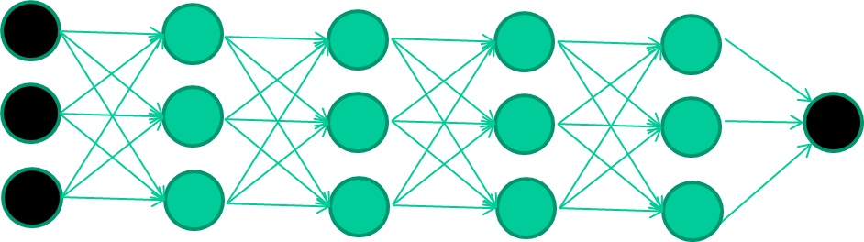
The new way to train multi-layer NNs…
Train this layer first

Slide 50
The new way to train multi-layer NNs…
Train this layer first
then this layer

Slide 51
The new way to train multi-layer NNs…
Train this layer first
then this layer
then this layer

Slide 52
The new way to train multi-layer NNs…
Train this layer first
then this layer
then this layer
then this layer

Slide 53
The new way to train multi-layer NNs…
Train this layer first
then this layer
then this layer
then this layer
finally this layer

Slide 54
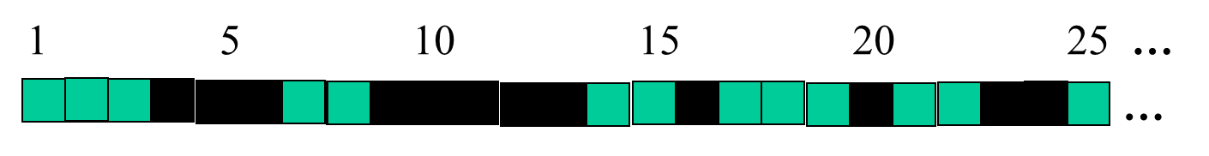
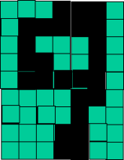
successive layers can learn higher-level features …
detect lines in
Specific positions
etc …
Higher level detetors
( horizontal line,
“RHS vertical lune”
“upper loop”, etc…
etc …
v

Slide 55
Outline
Deep learning
Greedy layer-wise training (for supervised learning)
Deep belief nets
Stacked denoising auto-encoders
Stacked predictive sparse coding
Deep Boltzmann machines
Convolutional Neural Net

Slide 56
Restricted Boltzmann Machines
Unsupervised
Find complex regularities in training data
Bipartite Graph
visible, hidden layer
Binary stochastic units
On/Off with probability
1 Iteration
Update Hidden Units
Reconstruct Visible Units
Maximum Likelihood of training data
j
hidden
w_{ij}
i
visible

Slide 57
Restricted Boltzmann Machines
Training Goal: Best probable reproduction
unsupervised data
find latent factors of data set
Adjust weights to get maximum probability of input data
j
hidden
w_{ij}
i
visible

Slide 58
Deep Belief Networks(DBNs)
Hinton et al., 2006
Probabilistic generative model
Deep architecture – multiple layers
Unsupervised pre-learning provides a good initialization of the network
maximizing the lower-bound of the log-likelihood
of the data
Supervised fine-tuning
Generative: Up-down algorithm
Discriminative: backpropagation

Slide 59
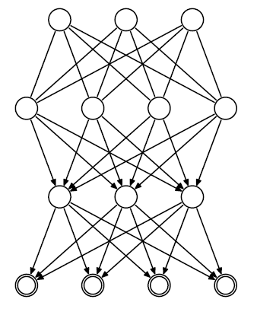






DBN structure
_{h}3
Hinton et al., 2006
RBM
Hidden
layers
_{h}2
_{h}1
Directed belief nets
Visible layer
v
P(v, h¹, h² ,..., h^{l} ) = P(v | h¹ )P(h¹ | h² )...P(h^{l−2} | h^{l−1})P(h^{l−1}, h^{l} )

Slide 60
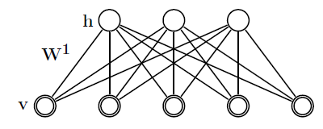
DBN Greedy training
Hinton et al., 2006
First step:
Construct an RBM with an input layer v and a hidden layer h
Train the RBM

Slide 61
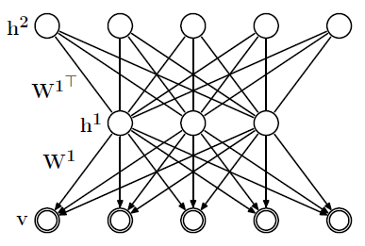

DBN Greedy training
Hinton et al., 2006
Second step:
– Stack another hidden
layer on top of the RBM
to form a new RBM
– Fix W¹, sample h¹ from
Q(h¹ | v) as input. Train
_{W}2
W
2
as RBM.
_{W}1
Q(h¹ | v)

Slide 62
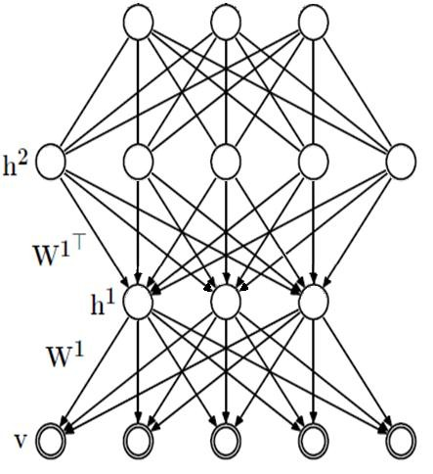
DBN Greedy training
Hinton et al., 2006
Third step:
_{h}3
_{W}3
– Continue to stack layers
on top of the network,
train it as previous step,
with sample sampled
from Q(h² | h¹)
And so on…
Q(h² | h¹)
W
2
_{W}1
Q(h¹ | v)

Slide 63
Why greedy training works?
Hinton et al., 2006
RBM specifies P(v,h) from
P(v|h) and P(h|v)
Implicitly defines P(v) and P(h)
Key idea of stacking
Keep P(v|h) from 1st RBM
Replace P(h) by the distribution generated by 2nd level RBM

Slide 64
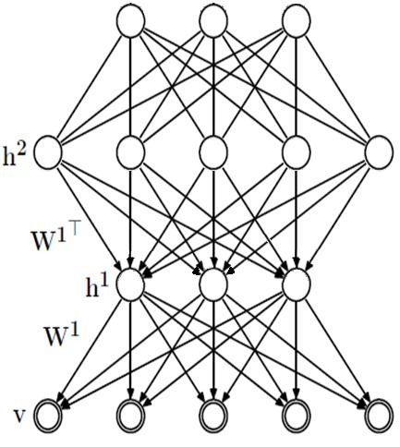

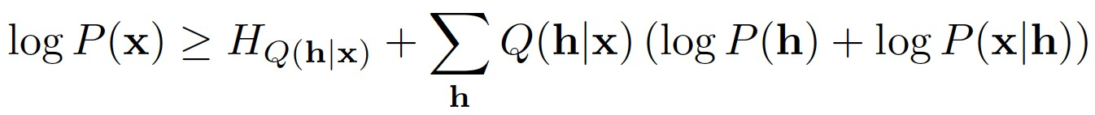
Why greedy training works?
Hinton et al., 2006
Easy approximate inference
_{h}3
P(h_{k+1}|h_{k}) approximated from the
associated RBM
Approximation because P(h_{k+1})
differs between RBM and DBN
Training:
– Variational bound justifies greedy
layerwise training of RBMs
_{W}3
Q(h² | h¹)
W
2
_{W}1
Q(h¹ | v)
Trained by the second layer RBM

Slide 65
Outline
Deep learning
Greedy layer-wise training (for supervised learning)
Deep belief nets
Stacked denoising auto-encoders
Stacked predictive sparse coding
Deep Boltzmann machines
Convolutional Neural Net

Slide 66
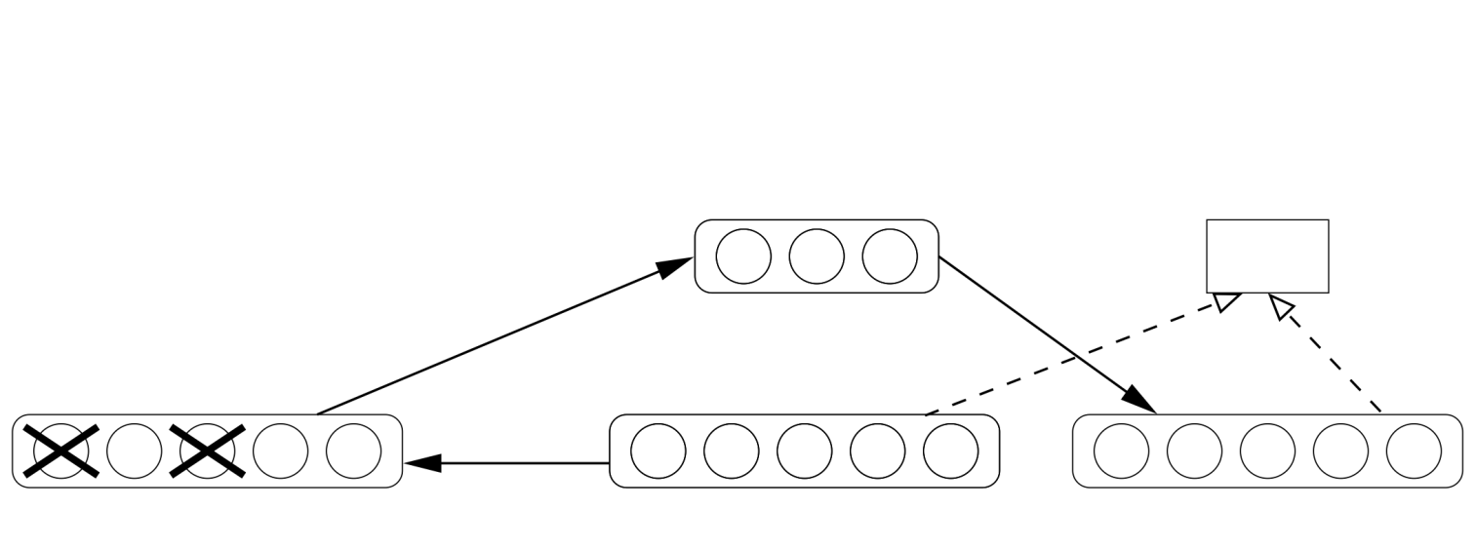
Denoising Auto-Encoder
(Vincent et al, 2008)
Hidden code (representation)
KL(reconstruction|raw input)
Corrupted input
Raw input
reconstruction
Corrupt the input (e.g. set 25% of inputs to 0)
Reconstruct the uncorrupted input
Use uncorrupted encoding as input to next level

Slide 67
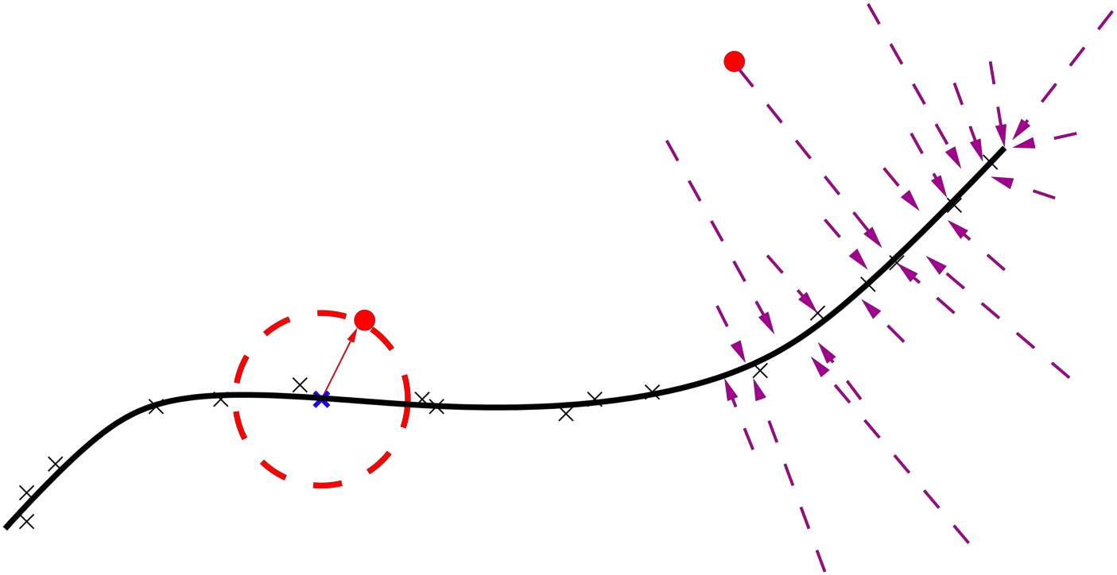

Denoising Auto-Encoder
(Vincent et al, 2008)
Learns a vector field towards
higher probability regions
Minimizes variational lower bound on a generative model
Corresponds to regularized
score matching on an RBM
Corrupted input
Corrupted input

Slide 68
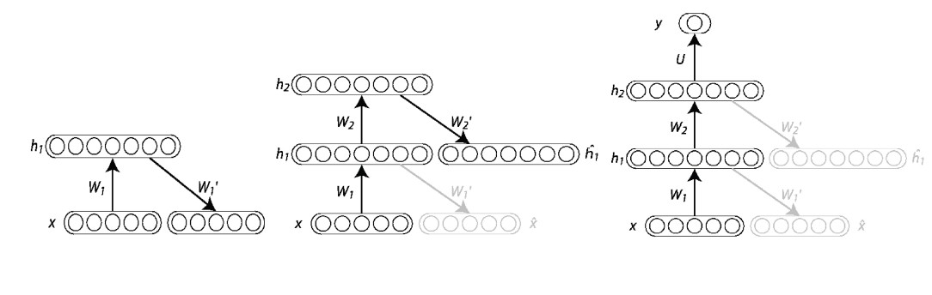
Stacked (Denoising) Auto-Encoders
Greedy Layer wise learning
Start with the lowest level and stack upwards
Train each layer of auto-encoder on the intermediate code (features) from the layer below
Top layer can have a different output (e.g., softmax non- linearity) to provide an output for classification

Slide 69
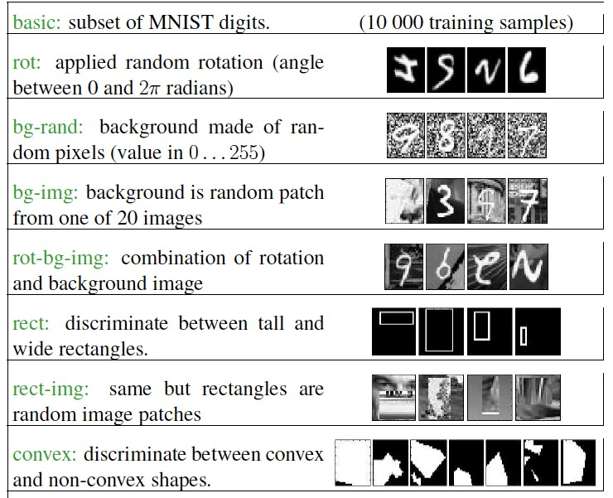
Denoising Auto-Encoders: Benchmarks
Larochelle et al., 2009

Slide 70
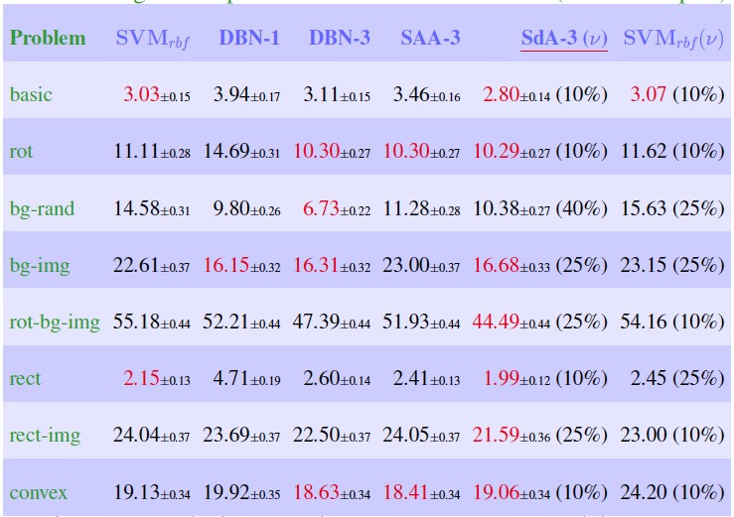
Denoising Auto-Encoders: Results
Test errors on the benchmarks
Larochelle et al., 2009

Slide 71
Outline
Deep learning
Greedy layer-wise training (for supervised learning)
Deep belief nets
Stacked denoising auto-encoders
Stacked predictive sparse coding
Deep Boltzmann machines
Convolutional Neural Net

Slide 72
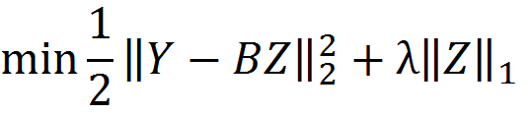
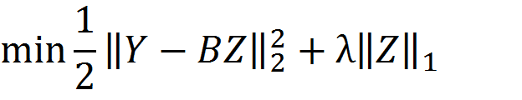

Predictive Sparse Coding
Recall the objective function for sparse coding:
Modify by adding a penalty for prediction error:
– Approximate the sparse code with an encoder

Slide 73

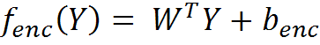
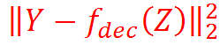
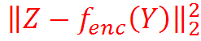
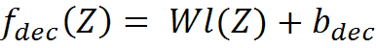



Encoder Decoder Model
Black = Function Red =Error
Input (Y)
Encoder
Decoder
Sparse Representation (Z)
…

Slide 74


35
Using PSD to Train a Hierarchy of Features
Phase 1: train first layer using PSD

Slide 75

Using PSD to Train a Hierarchy of Features
36
Phase 1: train first layer using PSD
Phase 2: use encoder+absolute value as feature extractor

Slide 76

Using PSD to Train a Hierarchy of Features
37
Phase 1: train first layer using PSD
Phase 2: use encoder+absolute value as feature extractor
Phase 3: train the second layer using PSD

Slide 77

Using PSD to Train a Hierarchy of Features
38
Phase 1: train first layer using PSD
Phase 2: use encoder+absolute value as feature extractor
Phase 3: train the second layer using PSD
Phase 4: use encoder + absolute value as 2nd feature extractor

Slide 78

Using PSD to Train a Hierarchy of Features
39
Phase 1: train first layer using PSD
Phase 2: use encoder+absolute value as feature extractor
Phase 3: train the second layer using PSD
Phase 4: use encoder + absolute value as 2nd feature extractor
Phase 5: train a supervised classifier on top
Phase 6: (optional): train the entire system with supervised back-propagation

Slide 79
Outline
Deep learning
Greedy layer-wise training (for supervised learning)
Deep belief nets
Stacked denoising auto-encoders
Stacked predictive sparse coding
Deep Boltzmann machines
Convolutional Neural Net
40

Slide 80

Deep Boltzmann Machines
Salakhutdinov & Hinton, 2009
Undirected connections between all layers
(no connections between the nodes in the same layer)
Slide credit: R. Salskhutdinov
41

Slide 81

DBMs vs. DBNs
Salakhutdinov & Hinton, 2009
In multiple layer model, the undirected connection between the layers make complete Boltzmann machine.

Slide 82





Two layer DBM example
*Assume no within layer connection.

Slide 83

Deep Boltzman Machines
Salakhutdinov & Hinton, 2009
Pre-training:
Can (must) initialize from
stacked RBMs
Generative fine-tuning:
Positive phase: variational approximation (mean-field)
Negative phase: persistent chain (stochastic approxiamtion)
Discriminative fine-tuning:
backpropagation

Slide 84



Experiments
MNIST: 2-layer BM
60,000 training and 10,000 testing examples
0.9 million parameters
Gibbs sampler for 100,000 steps
After discriminative fine-tuning: 0.95% error rate Compare with DBN 1.2%, SVM 1.4%
45

Slide 85

Experiments
NORB dataset
Slide credit: R. Salskhutdinov

Slide 86

Experiments
Slide credit: R. Salskhutdinov

Slide 87
Why Greedy Layer Wise Training Works
(Bengio 2009, Erhan et al. 2009)
Regularization Hypothesis
Pre-training is “constraining” parameters in a
region relevant to unsupervised dataset
Better generalization
(Representations that better describe unlabeled data are more
discriminative for labeled data)
Optimization Hypothesis
Unsupervised training initializes lower level parameters near localities of better minima than random initialization can
48

Slide 88
Outline
Deep learning
Greedy layer-wise training (for supervised learning)
Deep belief nets
Stacked denoising auto-encoders
Stacked predictive sparse coding
Deep Boltzmann machines
Convolutional Neural Net

Slide 89

Convolutional Neural Networks
(LeCun et al., 1989)
Local Receptive Fields
Weight sharing
Pooling

Slide 90

Deep Convolutional Architectures
State-of-the-art on MNIST digits, Caltech-101 objects, etc.

Slide 91

Deep Learning : A Theoretician’s Nightmare

Slide 92
A few popular Deep Learning tools
Theano (Python based and has very good documentation)
Torch (Has a new interpreter like language and facebook backed)
Tensorflow (Google backed)
Matlab Deep Learning Toolbox (But, sadly it does not have many implementation and it does not get regularly updated)
…

Slide 93
Main Issues
Still good in supervised learning but not that good in unsupervised learning (Need enough examples for training)
High dimensionality of the random variables being modeled.

Slide 94

Thanks

